Slide 1


2020
Lab 3: Object Oriented Programming in Python
Dr. Mohammed Al-Sarem
Taibah University, Information System Department
2/8/2020

Slide 2
Lab 3: Object Oriented Programing in Python
Lab Objectives:
Python is a class-based language. A class is a blueprint for an object that binds together specified variables and routines. Creating and using custom classes is often a good way to write clean, efficient, well-designed programs. In this lab we will first get familiar with basic structure of classes in Python and then get used to:
Familiarizing with pass by value and reference
Instantiating objects and calling methods.
Creating simple classes and working with objects
Using Constructors
Methodology
In class task:
At the end of this lab, the student will be able to:
Define and use Python classes.
Write a complete body of Python class and how to pass information through class’s constructor.
Instantiate a class and trigger a method inside the class.
Reuse code in other projects.
Home task:
References:
For more information, see:
https://www.w3schools.com/python/
https://www.programiz.com/python-programming/class
https://www.youtube.com/watch?v=UumoPVDRtlM
https://www.youtube.com/watch?v=ZDa-Z5JzLYM
https://www.youtube.com/watch?v=RSl87lqOXDE

Slide 3
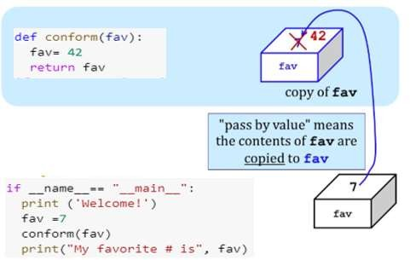
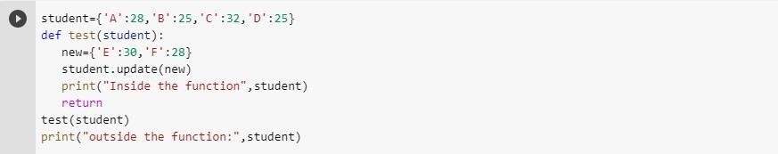
Lab 3: Object Oriented Programing in Python
1. Passing Variables by value and reference
Pass by value means that the value is directly passed as the value to the argument of the function. In this case, the operation is done on the value and then the value is stored at the address. Pass by reference is the term used in some programming languages, where values to the argument of the function are passed by reference, that is, the address of the variable is passed and then the operation is done on the value stored at these addresses. In Python arguments, the values are passed by reference. During the function call, the called function uses the value stored at the address passed to it and any changes to it also affect the source variable. Consider the following code:
Example 1.1:
In the main function, Did the value of fav variable change after invoking the main function?
Can you explain the reason behind that?
Python uses a mechanism, which is known as "Call-by-Object", sometimes also called "Call by Object Reference" or "Call by Sharing"
If you pass immutable arguments like integers, strings or tuples to a function, the passing acts like Call-by-value. It's different, if we pass mutable arguments.
All parameters (arguments) in the Python language are passed by reference. It means if you change what a parameter refers to within a function, the change also reflects back in the calling function.
Example 1.2:
Are the outputs same in both call? Write your observation below:

Slide 4
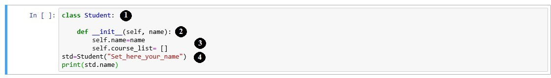
Lab 3: Object Oriented Programing in Python
Can you explain the difference between the outputs of Example 1 and Example 2??
Python Classes
Similar to any programming language that support Object-Oriented Concept, Python is built to be a class-based language. A class, in general, a code block that defines a custom object and determines its behavior. To define a class in Python, the first thing that you should use is Class keyword which defines and names a new class in Python. Other statements follow, indented below the class name, to determine the behavior of objects instantiated by the class. A class needs a method called a constructor that is called whenever the class instantiates a new object. The constructor specifies the initial state of the object. In Python, a class’s constructor is always named init (). An attribute is a variable stored within an object.
Exercise 2.1: Create a class Student whose two variable, name and list of courses studied during a semester. Initiate the class and display the result on Jupyter.
Lunch the Jupyter as shown before in the previous labs.
Write the code below on cell [].
Note:
The class name ends with ‘:’. Without the colons, Python’s interpreter
Student
will fail to recognize the class body.
Function is a constructor in which you can initial local variables of
init ()
the class. The “ keyword represents the instance of the class. By using
self”
“self” keyword, we can access the attributes and methods of the class in python. It binds the attributes with the given arguments.

Slide 5
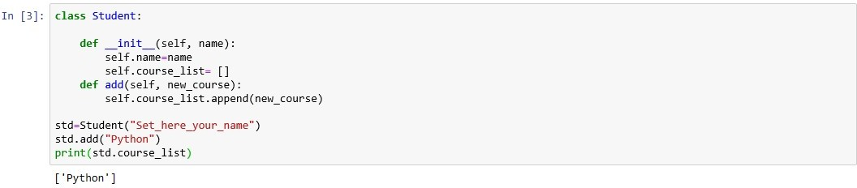
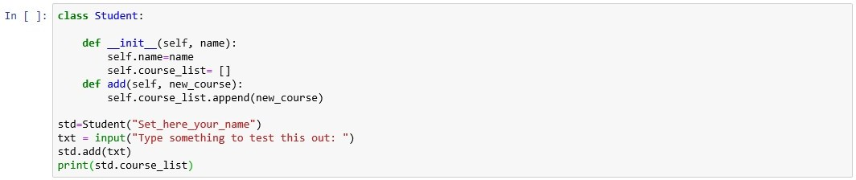
Lab 3: Object Oriented Programing in Python
Initialize some attributes
std is an object that instantiates class Student. Since we would to pass a value during the initialization, invoking class’s constructor and passing the value through it is the right place to set the class parameters.
Hooray, you wrote your first Python class.
2.1. Methods
In addition to storing variables as attributes, classes can have functions attached to them. A function that belongs to a specific class is called a method. Now, backing to what did you learn at the 2nd lab, initialize the course_list found in Student class. To do that:
Click on the cell [1] where you wrote your previous code. Then, below the
init () function, write the following code:
Exercise 2.2 In the function add(), the variable course_list is initialized by using the self keyword as we saw in the previous code. To add a new variable to the list we use the built-in function append(). Can you explain why we did that?
To not get two values mixed
.
Exercise 2.3 Add more courses to your list. Hint! Use a loop to ask user to add his preferred course to the list. Then remove an item from the list!

Slide 6
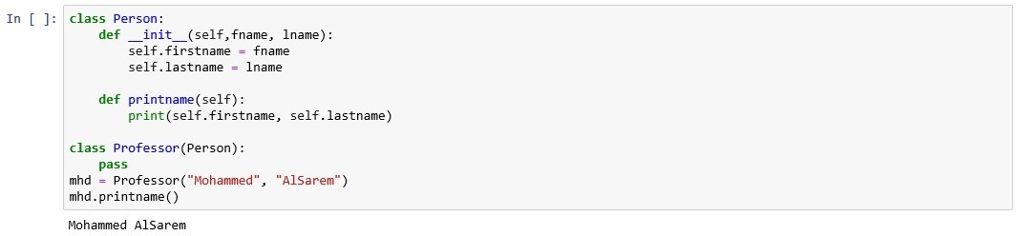
Lab 3: Object Oriented Programing in Python
class student:
def __init__(self, name):
self.name=name
self.course_list= []
def add(self, new_course):
self.course_list.append(new_course)
std=student("malik")
txt = input("enter a course here ")
std.add(txt)
print(std.course_list)
2.2. Inheritance
To create a new class that is similar to one that already exists, it is often better to inherit the methods and attributes from an existing class rather than create a new class from scratch. This creates a class hierarchy: a class that inherits from another class is called a subclass, and the class that a subclass inherits from is called a superclass. To define a subclass, add the name of the superclass as an argument at the end of the class declaration.
Exercise 2.4 In the code above, the class Professor contains a keyword. What did this mean?
pass
To occupy the place for future use of the function
Exercise 2.5 Replace the pass keyword in the child class with init () function. Note that The child's init () function overrides the inheritance of the parent's init () function.
class Person:
def __init__(self, fname, lname):
self.firstname = fname
self.lastname = lname
def printname(self):
print(self.firstname, self.lastname)
class Professor(Person):
def __init__(self, fname, lname):
self.department= 'IS'
Person.__init__(self, fname, lname)

Slide 7
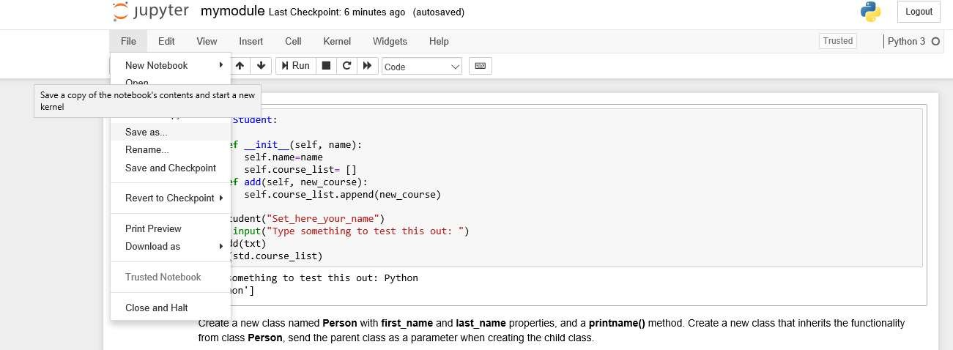
Lab 3: Object Oriented Programing in Python
Exercise 2.3 Add a new variable to child class and initialize its value. Print the result. Hint: to keep the inheritance of the parent's init__() function, add a call to the parent's init () function.
^
mhd = Professor("Mh","AS")
mhd.printname()
print(mhd.department)
1. Python Modules
A module is a file containing a set of functions you want to include in your application. To create a module just save the code you want in a file with the file extension *.py. To do that:
Let before saving our module to modify what we did during this lab. Add a new greeting(name)function. Separate the class body from the invoking process. Then, go to main menu of your Jupyter editor and click on File→ Save as. Then, save this code in a file named mymodule.py
The file will be saved in the active directory you set before. By default the file can be found by http://localhost:8888/tree
To use module, we just created, use import statement as follows:
Import mymodule
All the Best!!!

